Slide 1
Overview
Parallel Processing
Pipelining
Characteristics of Multiprocessors
Interconnection Structures
Inter processor Arbitration
Inter processor Communication and Synchronization

Slide 2
Multiprocessors
A multiprocessor system is an interconnection of two or more CPUs with memory and input-output equipments
Multiprocessors are classified as Multiple Instruction stream, multiple data stream (MIMD) systems
Multiprocessor and Multicomputer
    Similarity : both support concurrency
    Difference : multiprocessor controlled by one OS.
Emergence of microprocessor led to multiprocessor.
    Microprocessor take very little physical space and inexpensive
    VLSI technology has reduced cost of computer components that multiple processor became attractive design possibility for meet system performance requirement

Slide 3
Multiprocessors
Multiprocessing improves the reliability of the system (fault tolerant)
The benefit from multiprocessor organization is improved system performance.
The system derives its high performance from the fact that computation can be processed in parallel in one of the two ways:
    Multiple Independent jobs can be made to operate in parallel
    A single job can be partitioned into multiple parallel task
    - Ex: One processor –high speed computation, other- data processing task
The compiler checks the data dependency in the program. Two parts of a program that do not use data generated by each can run concurrently

Slide 4
Coupling of Processors
Multiprocessors are classified by the way their memory is organized.
Tightly Coupled System / Shared Memory System
- Multiprocessor system with common shared memory
- Tasks and/or processors communicate in a highly synchronized fashion
- Communicates through a common global shared memory
Loosely Coupled System / Distributed Memory System
- Each processor element has its own private local memory
- Tasks or processors do not communicate in a synchronized fashion
- Communicates by message passing packets
- Overhead for data exchange is high
- Most efficient when interaction between task is minimum

Slide 5
Memory
  Shared (Global) Memory
  - A Global Memory Space accessible by all processors
  - Processors may also have some local memory
  Distributed (Local, Message-Passing) Memory
  - All memory units are associated with processors
  - To retrieve information from another processor's memory a message must be sent there
  Uniform Memory
  - All processors take the same time to reach all memory locations
  Nonuniform (NUMA) Memory
  - Memory access is not uniform
SHARED MEMORY
Memory
DISTRIBUTED MEMORY
Network
Network
Processors
Processors/Memory

Slide 6
Shared Memory Multiprocessors
M
M
. . .
M
Buses,
Multistage IN,
Crossbar Switch
Interconnection Network
P
P
. . .
P
Characteristics
All processors have equally direct access to one large memory address space
Limitations
Memory access latency; Hot spot problem

Slide 7
Message Passing MultiProcessors
Message-Passing Network
Point-to-point connections
P
P
. . .
P
M
M
. . .
M
Characteristics
- Interconnected computers
- Each processor has its own memory, and communicate via message-passing
Limitations
- Communication overhead; Hard to programming

Slide 8
Interconnection Structure
The components that form a multiprocessor systems are CPUs, IOPs connected to input-output devices and a memory unit that may be partitioned into a separate modules.
The interconnection between components can have different physical configuration based on no. of transfer path b/w processor and memory . Some of the schemes are :-
(1). Time-Shared Common Bus
(2). Multiport Memory
(3). Crossbar Switch
(4). Multistage Switching Network
(5). Hypercube System

Slide 9
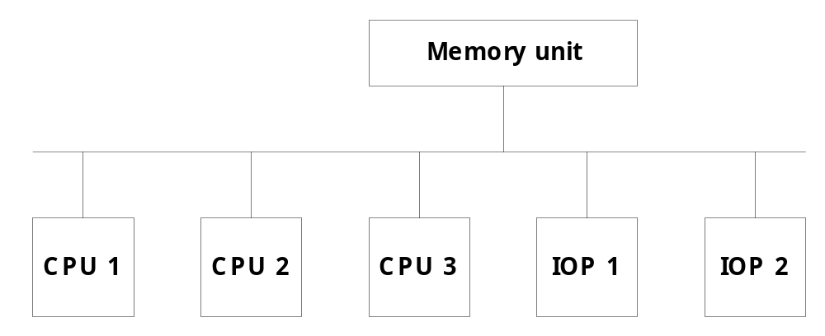
Time-Shared Common Bus
- Consists of no. of processors connected through a common path to
memory unit
- Memory access is fairly uniform, but not very scalable
Only one processor can communicate with the memory or another processor at any
given time
    when one processor is communicating with the memory, all other processors are either busy with internal operations or must be idle waiting for the bus

Slide 10
Time-Shared Common Bus
The system may exhibit transfer bus transfer conflict which must be resolved by incorporating a bus controller that establishes priorities among the resulting request
The processor can be kept busy through the implementation of two or more independent buses to permit multiple simultaneous bus transfer
System bus controller is used to link each local bus to common system bus
Only one processor can communicate with the shared memory at any given time
  The other processors are kept busy communicating with their local memory and I/O devices

Slide 11
System Bus Structure for Multiprocessor
Local Bus
Common
Shared
Memory
System
Bus
Controller
Local
Memory
CPU
IOP
SYSTEM BUS
System
Bus
Controller
Local
Memory
System
Bus
Controller
Local
Memory
CPU
IOP
CPU
Local Bus
Local Bus

Slide 12
Multi Port Memory
- It employs separate buses between each memory module and each CPU
Multiport Memory Module
- Each port serves a CPU
Memory Module Control Logic
- Each memory module has control logic
- Resolve memory module conflicts Fixed priority among CPUs
Advantages
- Multiple paths -> high transfer rate
Disadvantages
- Memory control logic
- Large number of cables and
connectors
Memory Modules
MM 1
MM 2
MM 3
MM 4
CPU 1
CPU 2
CPU 3
CPU 4

Slide 13
Cross Bar Switch
MM1
MM2
MM3
MM4
CPU1
CPU2
CPU3
CPU4
It consists of number of crosspoints that are placed at intersections between
Processor buses and memory module paths
Switch examines the address that is placed in bus to determine whether its
particular module is being addressed
Also resolves multiple request for access to same memory module on predefined
priority basis

Slide 14
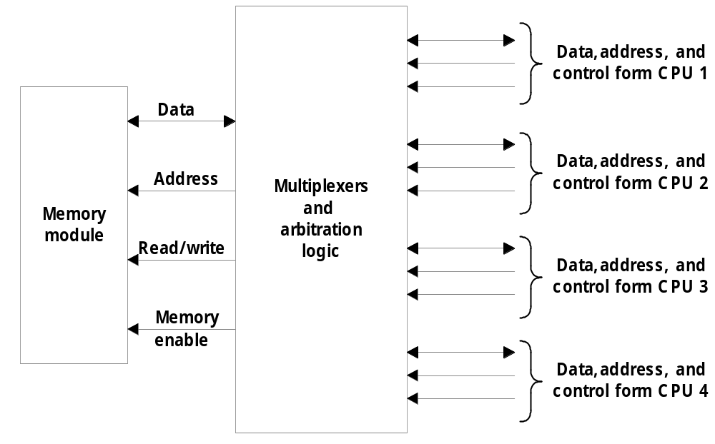
Cross Bar Switch
MM
CPUs
Priority levels are established by arbitration logic to select one CPU when two or
more CPUs attempt to access the same memory

Slide 15
Multi Stage Switching Network
Basic component of multistage network is 2 i/p, 2 o/p Interchange Switch
A
0
A
0
1
1
B
B
A connected to 0
A connected to 1
A
0
A
0
1
1
B
B
B connected to 0
B connected to 1
If input A and B both request the same output terminal only one of them will be
connected and other will be blocked

Slide 16
MultiStage Interconnection Network
Binary Tree with 2 x 2 Switches
0
000
0
1
001
1
0
010
P1
0
1
1
011
P2
0
100
0
1
1
101
0
110
1
111
Two processors connected through switches to 8 memory modules
Path from source to destination is determined from binary bits of destination number
Drawback : certain request patterns cannot be satisfied simultaneously, i.e if P1
connected to any of (000-011 ) then P2 can only be connected to one of (100-111)

Slide 17
MultiStage Interconnection Network
8x8 Omega Switching Network
0
000
1
001
2
010
3
011
4
100
5
101
6
110
7
111
There is exactly one path from each source to any particular destination
Disadvantage : some request pattern cannot be connected e.g. connection
simultaneously to destination 000 and 001

Slide 18
Hypercube Interconnection
Hypercube of binary n-cube multiprocessor structure is a loosely coupled system
Composed of N=2^{n} processors interconnected in an n-dimensional binary cube
n-dimensional hypercube (binary n-cube)
- p = 2^{n}
- processors are conceptually on the corners of a
n-dimensional hypercube, and each is directly
connected to the n neighboring nodes
- Degree = n
011
111
010
0
01
11
110
101
001
1
00
10
100
000
One-cube
Two-cube
Three-cube

Slide 19
Hypercube Interconnection
Each node is assigned a binary address in such a way that the address of two
neighbors differ in exactly 1 bit position
Routing messages through an n-cube structure may take from one to n links from a
source node to a destination node
A routing procedure can be developed by computing the EX-OR of source node
address with destination node address

